Slide 1
Lilly Project 3: Regulatory Natural Language Processing
--- By Team Members:
Prateesh Reddy
Himani Anil Deshpande
Krishna Vamsi Guntupalli
Venkata Kartheek Janapati
Victor Zitao Zhang
Chaitanya Deshpande
Notes:
(P)

Slide 2
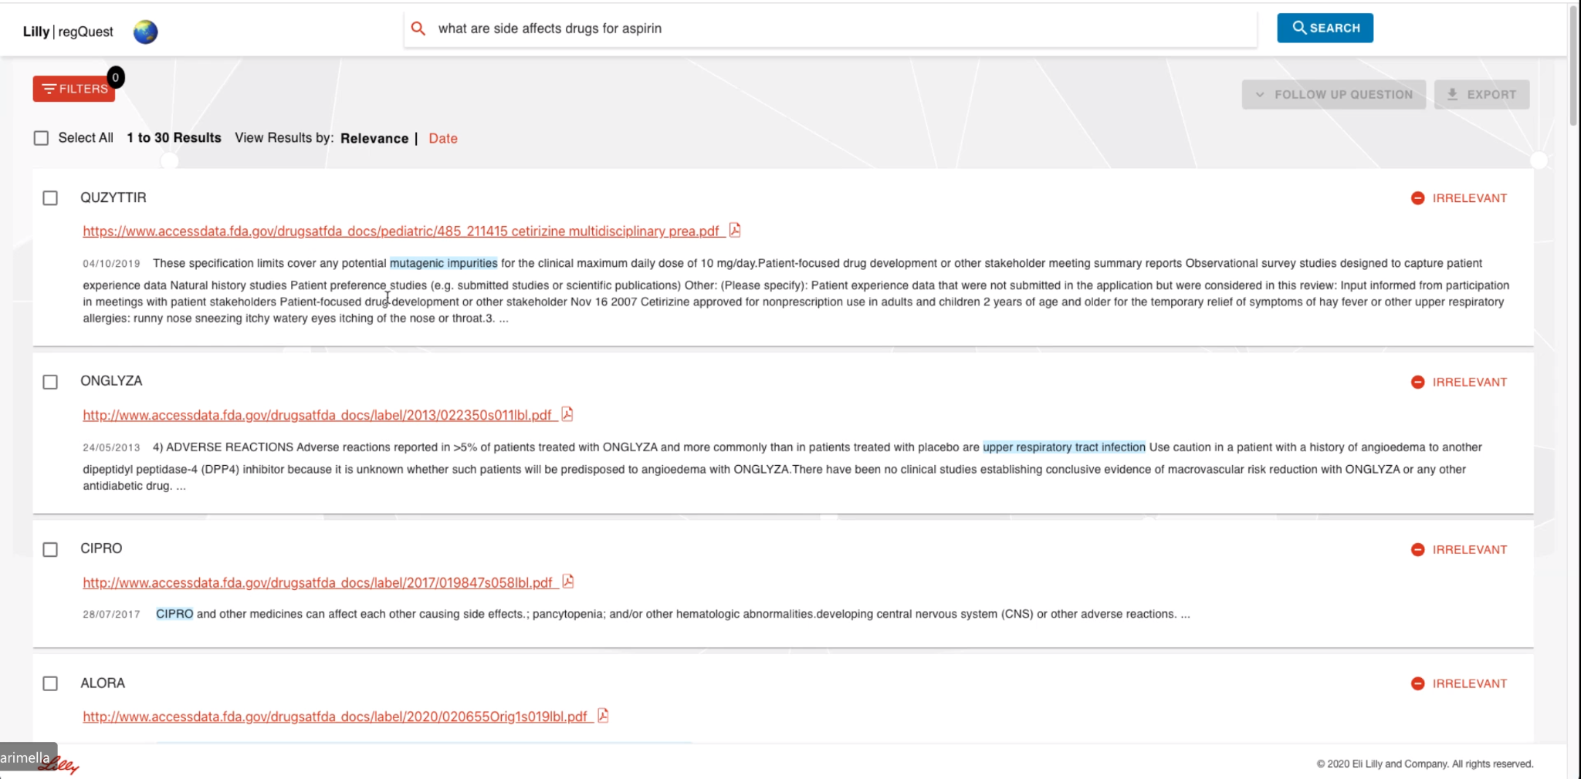
Overview of the Project
Lilly RegQuest :
To Provide Cognitive search capability to search against database like FDA and EMA (European medical agency) via a natural language question and return relevant results in order to help with accelerating regulatory submissions (which is important for Lilly).
Notes:
(P)

Slide 3
Project Objectives
To understand the data from dailymed.
To Scrape relevant data to the NLP question asked.
To understand and analyse state of the art text summarization algorithms.
To compare performance of Advanced NLP techniques on medical data and weigh out limitations.
To generalise and automate the summarization for searched NLP question.
Notes:
(P)

Slide 4
Text preprocessing
Need to filter out keywords/patterns which can obviously identify the sentences
Finding paragraphs by keywords will include a lot of “red herring” informations which will subsequently confuse the abstraction algorithm
NSAIDs cause an increased risk of serious gastrointestinal GI adverse events including bleeding ulceration and perforation of the stomach or intestines…
Table 1a depicts adverse events that occurred in ≥2% of the MOBIC treatment groups in a 12-week placebo- and active-controlled osteoarthritis trial…
See ADVERSE REACTIONS and DOSAGE AND ADMINISTRATION for
monitoring recommendations
Correct:
Incorrect:
Incorrect:
Notes:
(Z)
Even with only a dozen of xml files, manual cleaning and extracting the data would not be optimal. Because the result of the manual process of data scraping is not expandable to other documents, which defeats the purpose of using automated transformers. But there are challenges facing when it comes to rule based content extraction. Looking for keywords and patterns that can identify the sentences. However it also identifies statements that talks about the same topic but not providing useful information for the question being asked. This presents distraction information for the text summarization algorithm. Here’s an example. For question regarding what the adverse reactions are for a certain drug, As shown, the first sentence contains keyword adverse events with correct information. However the second and third although contain same keyword yet the sentence is a distraction to the text summarization algorithm.

Slide 5


Pre-processing of question 1
What are the most common adverse reaction?
Find block text that is a <paragraph> or <content>
Contain the word “adverse”
Exclude sentence like:
contact FDA …
adverse effects are identified
Notes:
(Z)
There are several ways to preprocess the text. First is to search any paragraph and content tag with keyword adverse, then try to exclude the sentences like “contact FDA for adverse effect”, generic statements like “adverse effects are identified” etc.

Slide 6
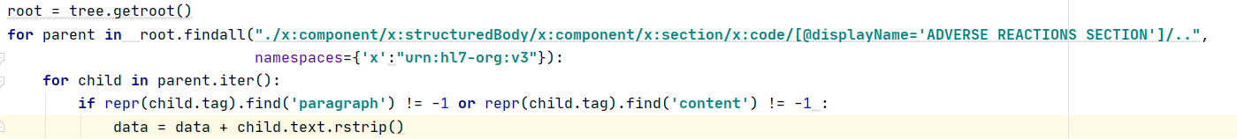
Pre-processing for question 1
What are the most common adverse reaction?
Find the Xpath of the Tag that we want
We focused on tag ADVERSE REACTIONS SECTION and all the text inside the tag
Notes:
(Z)
Another approach is more precise on finding the xpath that has the tag “adverse reaction section”. This produce less distraction content but will ignore useful information in other sections.

Slide 7
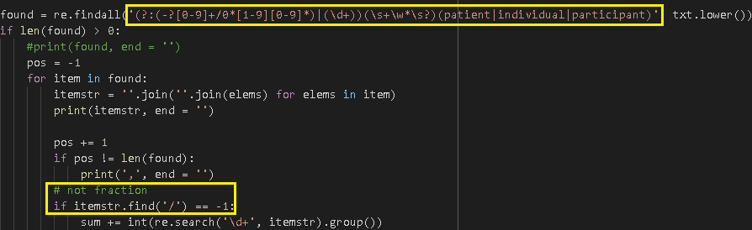
Pre-processing of question 2
The MOBIC Phase 2/3 clinical trial database includes 10,122 OA patients and 1012 RA patients treated with MOBIC 7.5 mg/day, 3505 OA patients and 1351 RA patients treated with MOBIC 15 mg/day.
How many patients were studied in total?
Find number followed by patient(s)/individual(s)/participant(s)
Accommodate some number written in xxx,xxx format (remove ‘,’ first)
Ignore fractions
Notes:
(Z)
For the question of “How many patients were studied in total?”, not all xmls have the total number of patient clearly stated. So the strategy here is to use search like regular expression to scrape all the possible sentences and then pass the sentences to the summarization algorithm. Also the preprocessor need to account for different format of writing number as here’s an example of the same paragraph with two different number format.

Slide 8
Issues on pre-processing
Will always find new pattern that need excluded as language is complex
Pattern matching can not exclude subset recounting for problems like “finding the total number of …”
Searching will not include sentences that use an alternative expression to keywords, for further development, the system will need to have a dictionary of synonyms
A total of 519 RA patients 65 years of age and older including 107 patients 75 years of age and older received HUMIRA
The pattern is found twice but only one should be valid
Notes:
(Z)
Overall, even with two questions we need to use radically different approaches for data scraping, where we believe it would always pose new challenges for each new question that needs to be processed. Also pattern matching does not understand the meaning where duplicated occurrences will add the same sentence multiple times like shown here. The 519 including 107, but rule based pre-processor will scrape both information. Also pattern matching will not include sentences that use an alternative expression to the keywords so ideally the system will at least need to have a dictionary of synonyms.

Slide 9
Learnings from data
We have the clinical data from the DailyMed website. On that website we have an XML format for any particular drug.
Each XML file has several sections, out of which we will be focusing on the Adverse Effects section.
The Adverse effects section is the 6th section in the XML file, and may contain subsections like 6.1, 6.2, etc.
We need to combine the data from the <paragraph> tags from each of the subsections and pass it to the summarization models.
The data might also contain table entries, which can be ignored because it doesn’t give us much information about adverse effects.
Notes:
(Z)
Now focusing on the first question, let’s go to the paragraphs that provides the answers. They are in xml or webpage form from the dailymed website. Each xml for a particular drug. The xmls have multiple sections, out of which we will be focus on the adverse effects sections. They are normally in the sixth sections may contains subsections. Some will not have them exclusively labeled out where we’ll need to use some of the shenanigans to scrape the content mentioned before. For text summarization, we need to combine the paragraphs into one long string to pass to the models. The data might also contain table entries which can be ignored. Sometimes the text will be too long and generate too many tokens for the algorithm to process so next will pass onto my teammates to talk about different models we looked into.

Slide 10
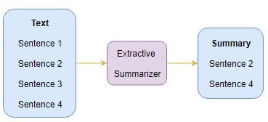
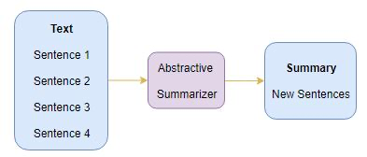
Types on Text Summarization
Two categories — Extractive Summarization and Abstractive Summarization.
Extractive Summarization: Rely on the existing text that has phrases, sentences to create a new summary. So, we need to identify key words or sentences of the existing text.
Abstractive Summarization: Uses advanced NLP techniques to generate an entirely new summary which will not contain phrases or sentences that exist in the original text. It is closer to what humans usually expect from text summarization. The process is to understand the original document and rephrase the document to a shorter text while capturing the key points.
Notes:
(P)
What methods are you summarizing

Slide 11
Extractive Summarization
A subset of words that represent the most important points is pulled from a piece of text and combined to make a summary.
Unsupervised approach: *TextRank (Genism, TextRank)
Heuristic approach: TextTeaser
Notes:
(P)
Text Rank
remove stopwords and stem the remaining sentences
create a graph where vertices are sentences
connect the sentences using edges, the value of edge is determined by the similarity of the sentences
Run pagerank on the graph
Pick sentences with highest PageRank score
TextTeaser associates a score with every sentence. This score is a linear combination of features extracted from that sentence.
Ref: Lin, C.Y. and Hovy, E., 2003. The potential and limitations of automatic sentence extraction for summarization. In Proceedings of the HLT-NAACL 03 Text Summarization Workshop (pp. 73-80).

Slide 12
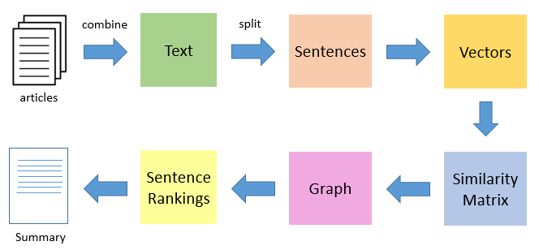
TextRank Algorithm
Graph-based Ranking Algorithms
Unsupervised Algorithm for Keyword Extraction and Text Summarization
Similarities between sentence vectors are then calculated and stored in a matrix
The similarity matrix is then converted into a graph, with sentences as vertices and similarity scores as edges, for sentence rank calculation
Finally, a certain number of top-ranked sentences form the final summary
Notes:
(P)
Mihalcea, Rada. "Graph-based ranking algorithms for sentence extraction, applied to text summarization." In Proceedings of the ACL interactive poster and demonstration sessions, pp. 170-173. 2004.
“A way of deciding the importance of a vertex within a graph, based on information drawn from the graph structure.”

Slide 13
Our Summary for TextRank
What are the most common adverse reaction?
Text Rank Algorithm Output :
Discontinue fenofibrate and treat patients appropriately if SCAR is suspected..Most common adverse reactions (> 2% and at least 1% greater than placebo) are abnormal liver tests, increased AST, increased ALT, increased CPK, and rhinitis (.Because clinical trials are conducted under widely varying conditions, adverse reaction rates observed in the clinical trials of a drug cannot be directly compared to rates in the clinical trials of another drug and may not reflect the rates observed in clinical practice..The following adverse reactions have been identified during post approval use of fenofibrate.
Photosensitivity reactions have occurred days to months after initiation; in some of these cases, patients reported a prior photosensitivity reaction to ketoprofen..Limited available data with fenofibrate use in pregnant women are insufficient to determine a drug associated risk of major birth defects, miscarriage or adverse maternal or fetal outcomes.
Notes:
(P)

Slide 14
Limitations (Extractive)
It summarizes most relevant sentences. So, It might not make a meaningful sentences everytime.
Ignores important word that appeared in low frequency.
Not feasible to implement summarization on medical data
Notes:
(P)
https://iq.opengenus.org/text-summarization-techniques/

Slide 15
Other Extractive Text Summarization Algorithm
Apart from TextRank algorithm, we have a few more extractive algorithms under “sumy” library:
LexRank- This algorithm uses the concept wherein a sentence which is similar to many other sentences of the text has a high probability of being important. Based on these probabilities, summary is decided.
Luhn- Luhn’s algorithm is a naive approach based on TF-IDF and looking at the “window size” of non-important words between words of high importance.
Latent Semantic Analysis- This algorithm combines Term frequency with Singular Value Decomposition.
Kullback-Lieber-Sum- This algorithm is a greedy method which adds sentences to the summary as long as the KL Divergence (a measure of entropy) is decreasing.
Notes:
(P)
Might need to blow through this slide

Slide 16
Abstractive Summarization
*A neural network approach
Recurrent neural network
LSTM/BRU
BERT
BART
T5
GPT2/3 (Open AI)
Tree-based approach
Template-based approach
Rule-based approach
Notes:
(H)
We exclusively used existing pre-trained models as we do not have a lot of data to train the model.

Slide 17
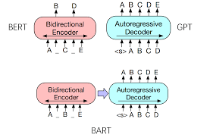
BART Transformers
Bidirectional and Auto-Regressive Transformers (Lewis et al., 2019)
BERT is a Bidirectional Transformer with a Masked Language Modelling uses seq2seq/machine translation architecture.
GPT is a autoregressive model which uses left to right decoder.
Allows Token Masking, Token Deletion, Text Infilling
from_pretrained() -> tokenizer.encode() -> model.generate() -> tokenizer.decode
Notes:
(H)

Slide 18
Our Summary for BART
What are the most common adverse reaction?
Most common adverse reactions are: Rheumatoid and Psoriatic Arthritis, upper respiratory tract infection, nasopharyngitis, diarrhea, and headache. The proportion of patients who discontinued treatment due to any adverse reaction during the 0 to 3 months exposure was 4% for patients taking XELJANZ and 3% for placebo-treated patients. The most common types of malignancy were lung and breast cancer.
Notes:
(H)

Slide 19
Limitations
The maximum number of tokens which can be generated is 1024.
LM and pre-training techniques do not provide the full picture.
It can only deal with fixed-length text strings. The text has to be split into a certain number of segments or chunks before being fed into the system as input
This chunking of text causes context fragmentation. For example, if a sentence is split from the middle, then a significant amount of context is lost. In other words, the text is split without respecting the sentence or any other semantic boundary
Notes:
(H)
Might need to blow through this slide

Slide 20
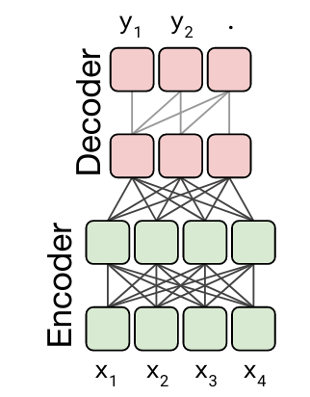
T5 Algorithm
The T5 Algorithm is a pre-trained abstractive summarization algorithm introduced by Google, which also uses Transformers along with the encode-decode approach. It is pre-trained on the Colossal Clean Crawled Corpus.
We pass the string generated from the “Adverse Effects” section of the XML file along with the tokens from T5Tokenizer and generate a tokenized text.
The maximum number of tokens which can be generated by the tokenizer is 512.
Using the model generated from T5ForConditionalGeneration, we create the summary IDs, which are further decoded to generate the summary of a particular text.
Notes:
(C)

Slide 21
Output for T5 Algorithm
We ran the T5 Algorithm on Adverse Effects on the drug AVEED, and we got a summary as follows:
AVEED was evaluated in an 84-week clinical study using a dose regimen of 750 mg (3 mL) at initiation, at 4 weeks, and every 10 weeks thereafter in 153 hypogonadal men. the most commonly reported adverse reactions (>2%) were acne (5.2%), injection site pain (4.6%), prostate specific antigen increased (4.6%), hypogonadism (2.6%) and estradiol increased (2.6%).
Notes:
(C)

Slide 22
Example of T5-large vs Wikihow-T5-Small
T5-large ''Most common adverse reactions to COUMADIN are fatal and nonfatal hemorrhage from any tissue or organ'' warfarin crosses the placenta, and concentrations in fetal plasma approach the maternal values. exposure to warfarin during the first trimester of pregnancy caused a pattern of congenital malformations in about 5% of exposed offspring. warfarin embryopathy is characterized by nasal hypoplasia with or without stippled epiphyses...
wikihow-T5-small 'Other adverse reactions to COUMADIN are fatal and nonfatal hemorrhage from any tissue or organ.'Consider fetal plasma exposure to warfarin during the first trimester of pregnancy.Consider nasal hypoplasia with or without stippled epiphyses (chondrodysis).Consider stipled epiphyses.Consider a stipled stippled stipple stipples.Consider the effects of warfarin in humans.
Notes:
(C) Different fine-tuned version of the same transformer gives different output, the output at times clearly contains undesired content. The reason is that the abstraction algorithm does not take what information it is trying to prioritize (AKA context), it will try to grab the sentences that it thinks is the most important. Which brings up an important question of the pre-processing (AKA cleaning) of the data. One manual way of doing it is identify the keywords in sentences that is undesirable then have the preprocessor exclude those sentences with these keyword. However this method has a big chance of mis-triggering and filtering out some useful information.
For full output with all the xmls, see appendix I and II

Slide 23
Limitations of T5 Algorithm
The Limitations of the T5 Algorithm are:
Despite changing the length_penalty parameter for our text, the output size does not have a significant difference in the summary.
Since the maximum number of tokens which can be generated by the T5 algorithm is 512, we only get a small sized summary for our text. If we want a larger size summary, we will not get desirable results.
This algorithm also requires good processing speed and power like GPUs, so it isn’t very convenient to use it on local machines if we wish the scan all the XML files.
Algorithm is not context aware, can not effectively exclude sentences that does not fit the theme
Notes:
(C)

Slide 24
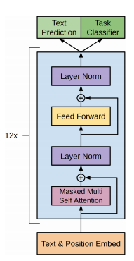
GPT-2 Algorithm
Is a seq2seq algorithm developed by OpenAI which stands for Generative Pre-trained Transformer.
Uses masked self-attention.
Uses byte pair encoding(BPE)
“text = summary”
Uses larger context and vocabulary size
Notes:
(KR)

Slide 25
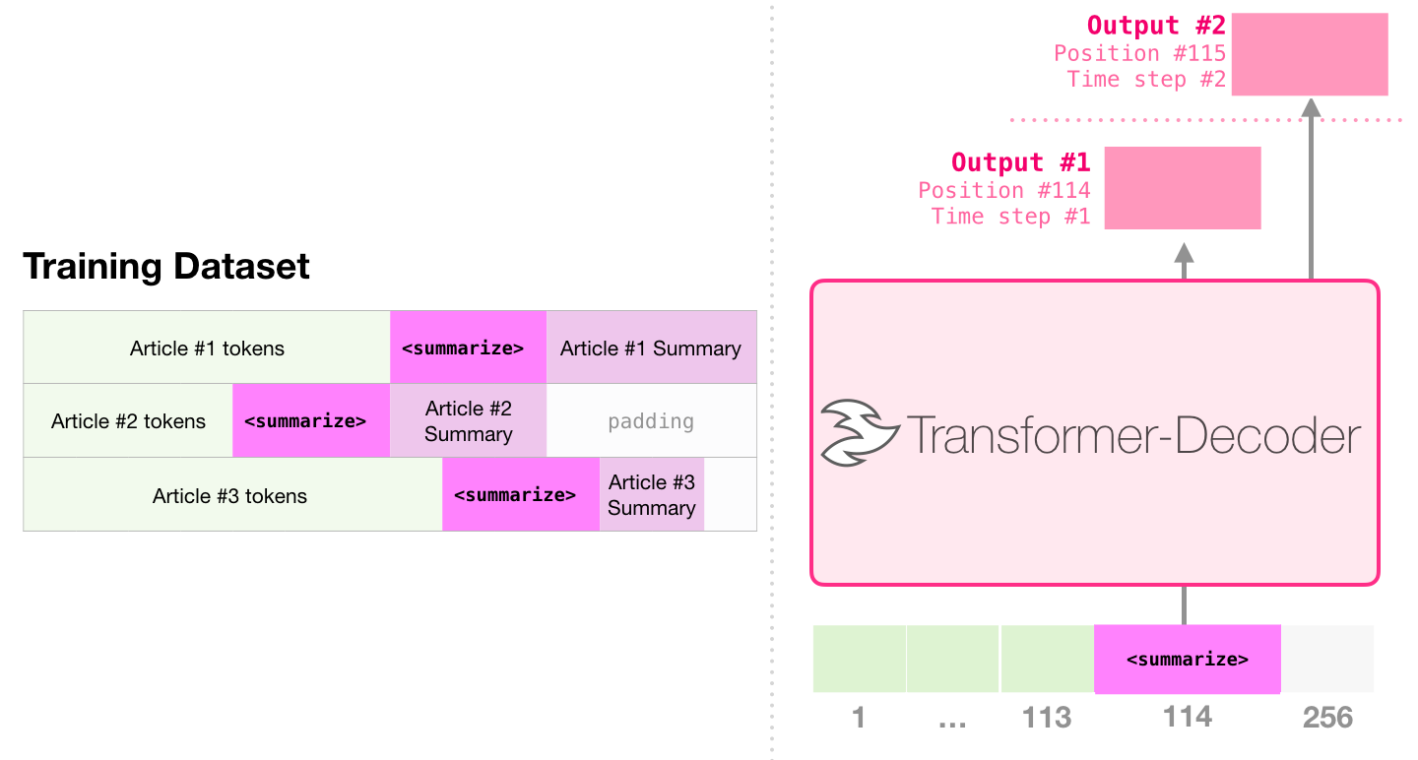
GPT-2 Coding Format
Import GPT2Tokenize and GPT2LMHeadModel
Encode the text
Pass them to model.generate()
Decode to generate the text summary.
Notes:
(KR)

Slide 26
Text Summary Output for GPT-2
For the question What are the most common adverse reactions?
The following clinically significant adverse reactions are described elsewhere in the labeling: Serious Infections. Most common adverse reactions are: Rheumatoid and Psoriatic Arthritis: Reported during the first 3 months in rheumatoid arthritis controlled clinical trials and occurring in ≥2% of patients treated with XELJANZ monotherapy or in combination with DMARDs: upper respiratory tract infection, nasopharyngitis, diarrhea, and headache. Because clinical studies are conducted under widely varying conditions, adverse reaction rates observed in the clinical studies of a drug cannot be directly compared to rates in the clinical studies of another drug and may not predict the rates observed in a broader patient population in clinical practice. All seven protocols included provisions for patients taking placebo to receive treatment with XELJANZ at Month 3 or Month 6 either by patient response (based on uncontrolled disease activity) or by design, so that adverse events cannot always be unambiguously attributed to a given treatment.
OUTPUT:
The most common Adverse Reactions are Rheumatoid and Psoriatic Arthritis: Reported during the first 3 months in rheumatoid arthritis controlled clinical trials and occurring in ≥2% of patients treated with XELJANZ monotherapy or in combination with DMARDs: upper respiratory tract infection, nasopharyngitis, diarrhea, and headache.
Notes:
(KR)

Slide 27
GPT-2 Limitations
Output size does not have a significant difference in the summary
The maximum number of tokens GPT-2 can be generated is 512
Were at most only 70% of the time correct, independent of the model used
Not equipped to handle complex and long language formations
Notes:
(KR)

Slide 28
Generalise & Automate Text Summarization
Inspiration :
Until now summarization by keywords from the NLP question
Need for Question Answering type approach
Inspired by BERT for Question Answering on SQuAD 2.0 by Stanford
Summarize the most appropriate answers instead of keywords using BART
Notes:
(KA)

Slide 29
BART Question and Answer
Pre-trained Using SQuAD 2.0
Search for best token based on question token using BartForQuestionAnswering
Append these into answer_array
Input this array to our previously implemented BART to generate summary
Notes:
(KA) Stanford Question Answering Dataset

Slide 30
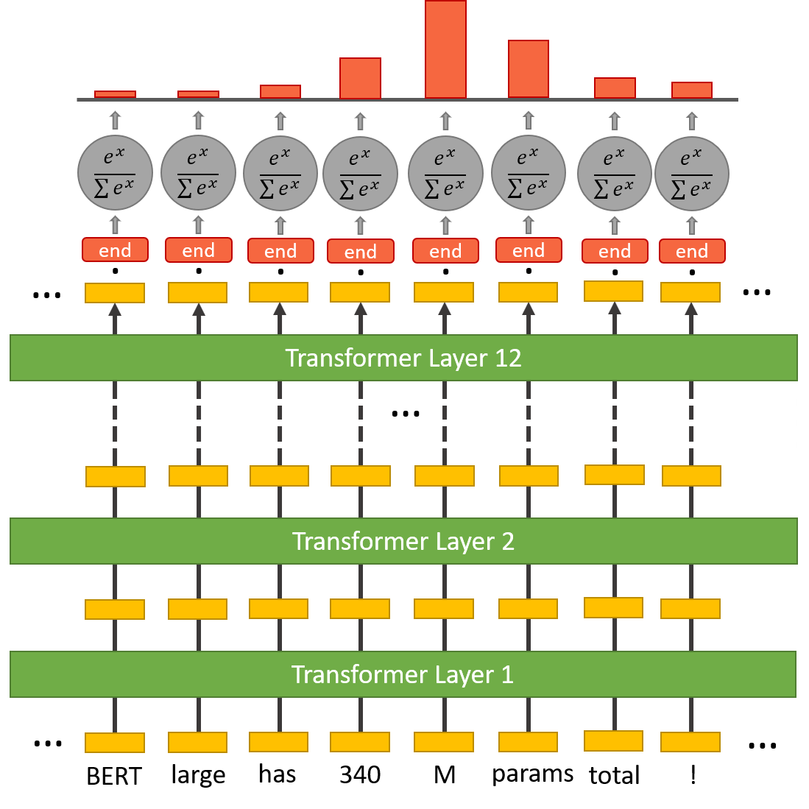
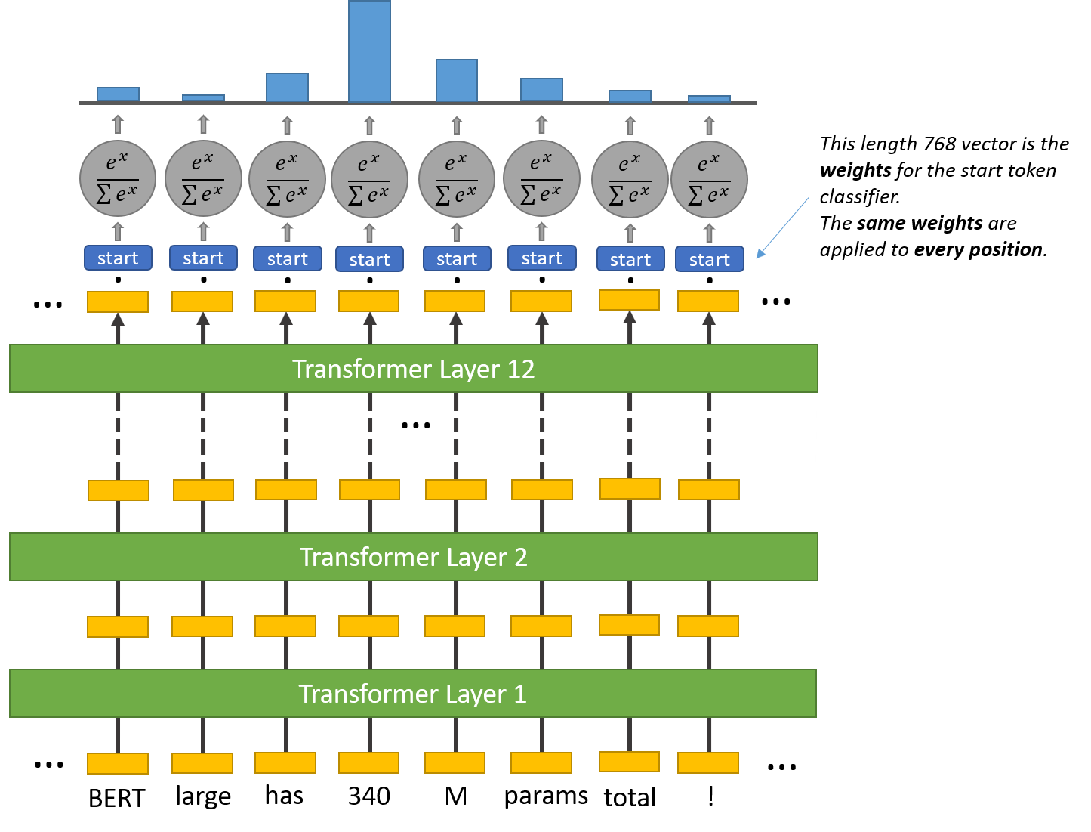
BART Question Answering
Notes:
(KA)

Slide 31
Limitation
It tries to find words to get a best answer
If the best answer is wrong, it will still produce it
Summary Concentrates more on correctness than human readable.
Cutting Edge Research.Thus, No concrete evidence or research on this approach yet.
Notes:
(KA)

Slide 32
Comparing Models
What are the most common adverse reaction?
BART: Most common adverse reactions are: Rheumatoid and Psoriatic Arthritis, upper respiratory tract infection, nasopharyngitis, diarrhea, and headache. The proportion of patients who discontinued treatment due to any adverse reaction during the 0 to 3 months exposure was 4% for patients taking XELJANZ and 3% for placebo-treated patients. The most common types of malignancy were lung and breast cancer.
BART QnA: NUZYRA was evaluated in three Phase 3 clinical trials (Trial 1, Trial 2 and Trial 3). The most common adverse reactions (incidence ≥2%) are nausea, vomiting, infusion site reactions, alanine aminotransferase increased, and hypertension.
GPT-2: The most common Adverse Reactions are Rheumatoid and Psoriatic Arthritis: Reported during the first 3 months in rheumatoid arthritis controlled clinical trials and occurring in ≥2% of patients treated with XELJANZ monotherapy or in combination with DMARDs: upper respiratory tract infection, nasopharyngitis, diarrhea, and headache.
T5: 'Most common adverse reactions to COUMADIN are fatal and nonfatal hemorrhage from any tissue or organ'' warfarin crosses the placenta, and concentrations in fetal plasma approach the maternal values. exposure to warfarin during the first trimester of pregnancy caused a pattern of congenital malformations in about 5% of exposed offspring. warfarin embryopathy is characterized by nasal hypoplasia with or without stippled epiphyses...

Slide 33
Challenges we faced
Original problem of patient narrative didn’t have processable data, so we got a new topic at around week 3/4
Semi-structured Data
Not all the XML had ADVERSE EFFECTS Tag
The maximum tokens we could work with were 512/1024, which was less as we had a large input sequence to work with.
Notes:
In conclusion these are all the main challenges we faced

Slide 34
Future work
How to build context awareness for text preprocessor
Proper evaluation metric (ROUGE/BLEU only deal with grammar)
Find discriminator algorithm for recognizing obviously wrong answers
Optimize the question-answering model into the text of second question
Use HPC platform
Notes:
If time allow can expand:
For further improvement, we will need to build context awareness for the text preprocessor. Although the question and answer model is somehow aware of the context, when the content of certain context does not exist, it will find information with the wrong context. Second is the proper evaluation metric. Existing metric like ROUGE or BLEU scores only deal with the grammar of the sentence generated so we pretty much had to manually read the output when testing those algorithms because a lot of times the output was grammatically correct but contains incorrect information. Also it would be great if we can find a discriminator algorithm that can reject obviously wrong answers. The questions and answer model into second question can also be improved as it seems the algorithm always grabs a number for the second question so it produces more wrong answers than the first question. Also because we are not running on large datasets for this given task, we did not use the high performance computing platform. However in the process some task clearly generated out of memory error. So in the future we need to learn to put these jobs to run on the high performance computing platform.

Slide 35
References
BART: Denoising Sequence-to-Sequence Pre-training for NLG (Research Paper Walkthrough) - Youtube
Transformers In NLP | State-Of-The-Art-Models - Analytics Vidhya
BERT for Question Answering on SQuAD 2.0 - Stanford
TextRank: Bringing Order into Texts - Rada Mihalcea and Paul Tarau (UMitch)

Slide 36
Thank You !
&
Questions ?

